Slide 1
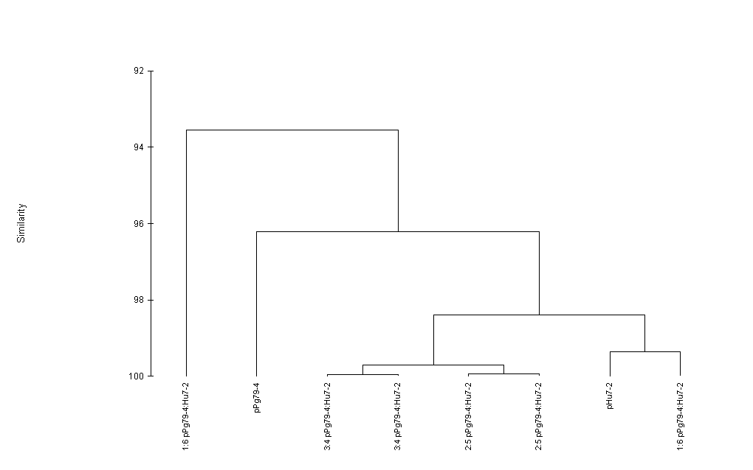
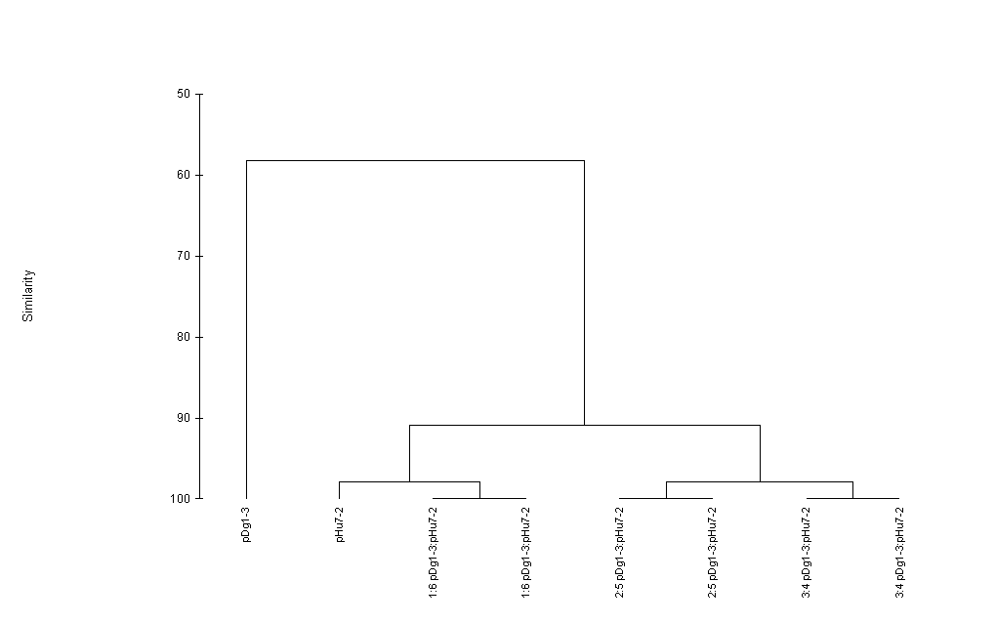
At base #35, consensus is an A (Hu7-2)
Dg1-3 has A35C which will cause a pyroshift
Pg79-4 has an A35G which will not cause a pyroshift

